Slide 1
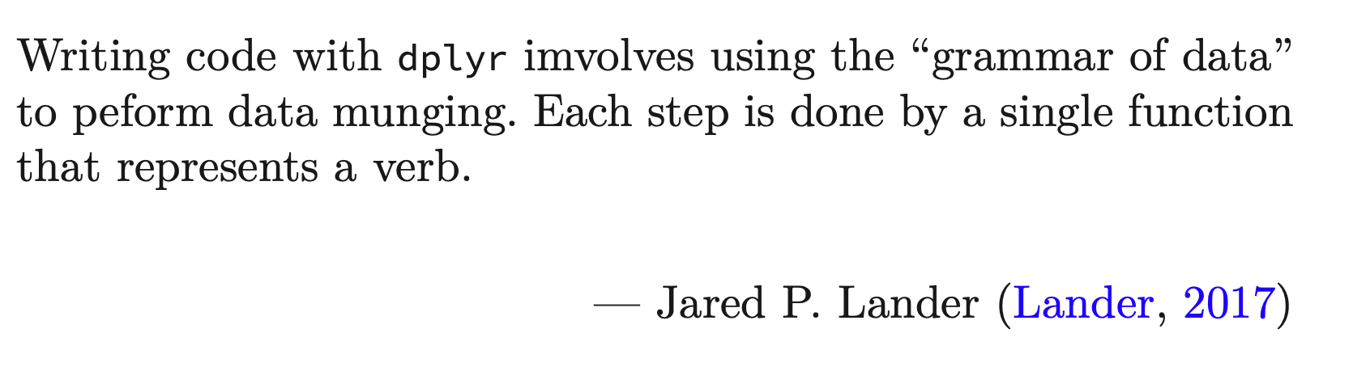
Data Science for Operational Researchers using R
06 – dplyr
https://github.com/JimDuggan/explore_or

Slide 2
Course Overview
Topic | Description
 | Morning 1
1 | Introduction to R and Posit Cloud
2 | Atomic Vectors
3 | Functions, Lists and Functionals
4 | Data Frames and Tibble
5 | ggplot2
 | Morning 2
6 | Data transformation with dplyr
7 | Relational Data with dplyr
8 | OR Example 1 – Exploratory Data Analysis
9 | OR Example 2 – System Dynamics

Slide 3
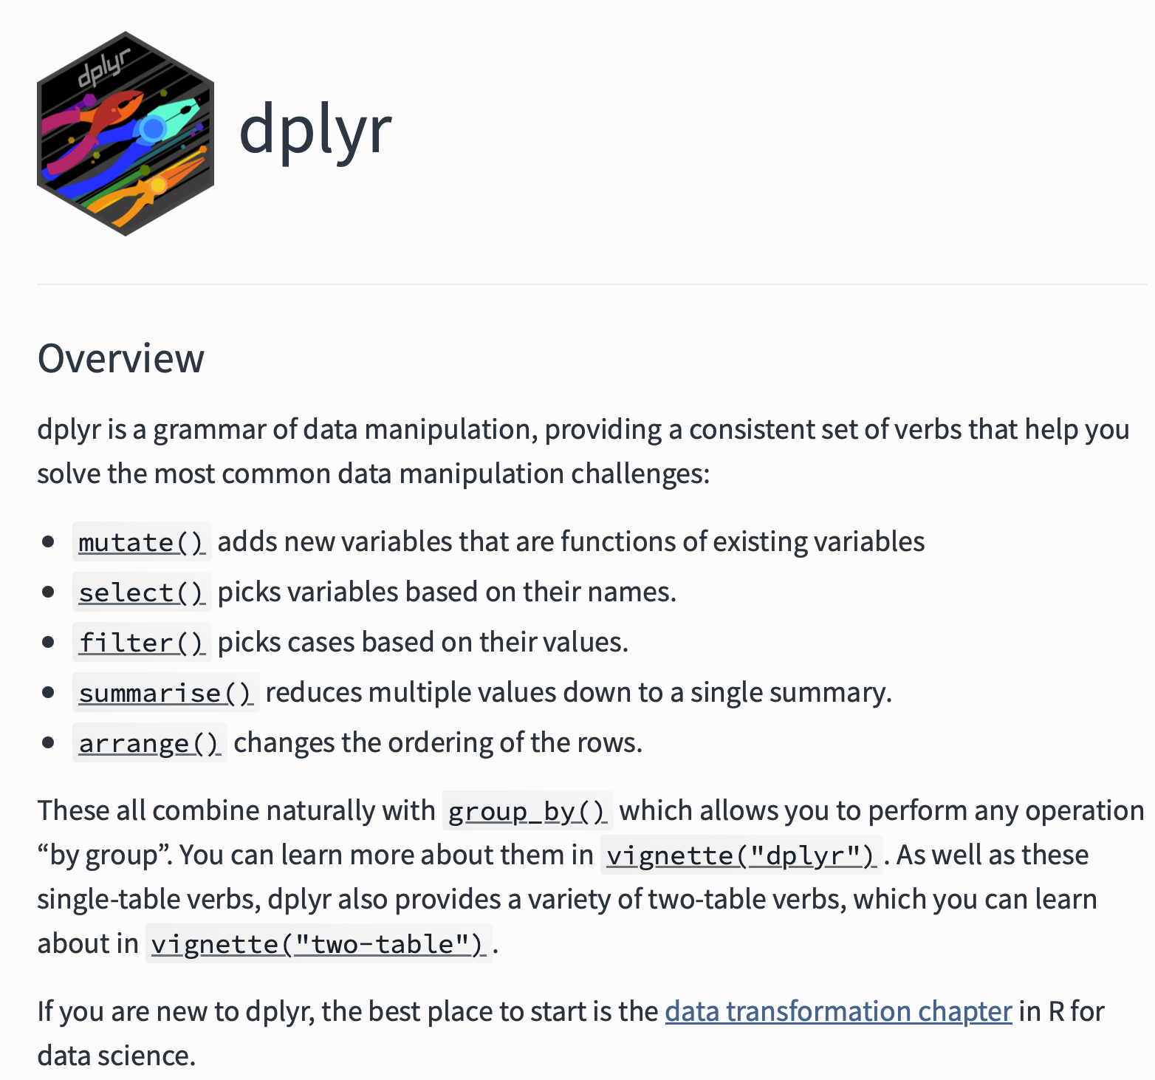
Overview
dplyr provides similar functionality to subset() and transform(), while also supporting aggregation of data
“tibble in, tibble out”
Elegant architecture, based on the “5 verbs”
Makes us of the tidyverse pipe %>%
https://dplyr.tidyverse.org

Slide 4
dplyr Basics: 5 key functions
Function | Purpose
filter() | Pick observations by their values
arrange() | Reorder the rows
select() | Pick variables by their names
mutate() | Create new variables with functions of existing variables
summarise() | Collapse many values down to a single summary
”A grammar of data manipulation”
All verbs (functions) work similarly
The first argument is a data frame/tibble
The subsequent arguments decide what to do with the data frame/tibble
The result (data frame/tibble) supports chaining of steps – NOTE the “pipe operator” which we will cover later.
https://dplyr.tidyverse.org

Slide 5
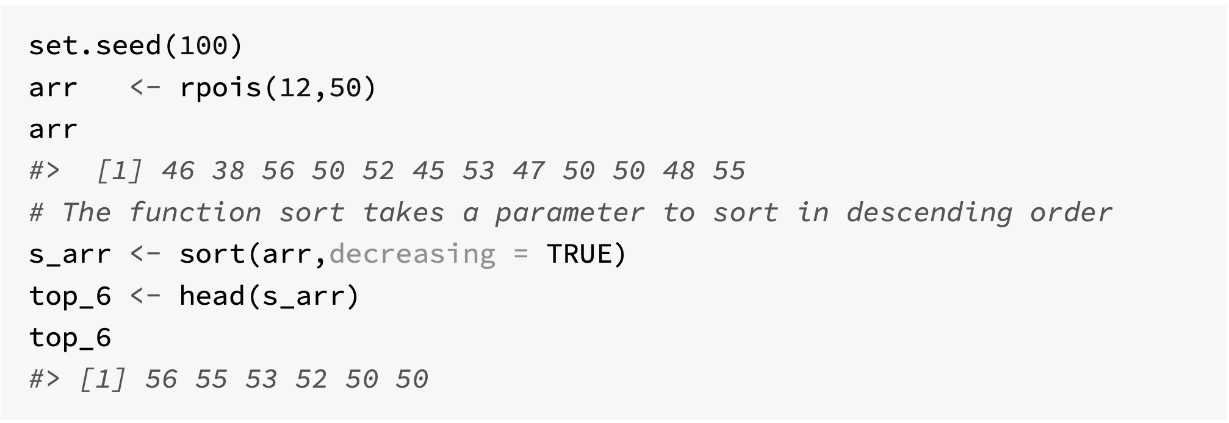
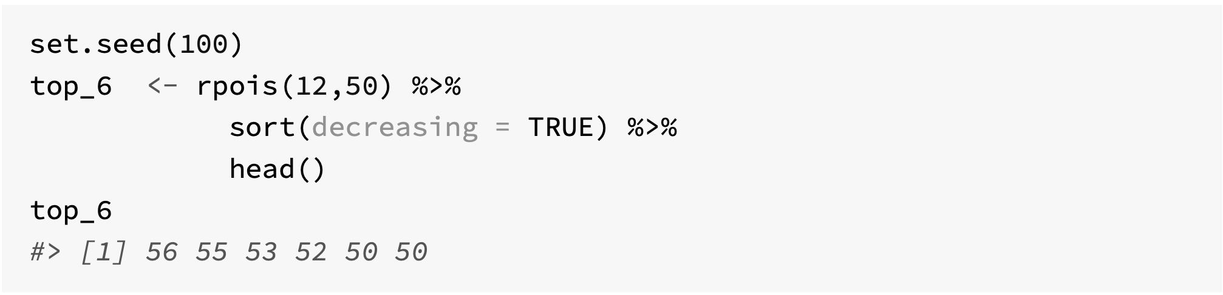
The tidyverse pipe - magrittr

Slide 6
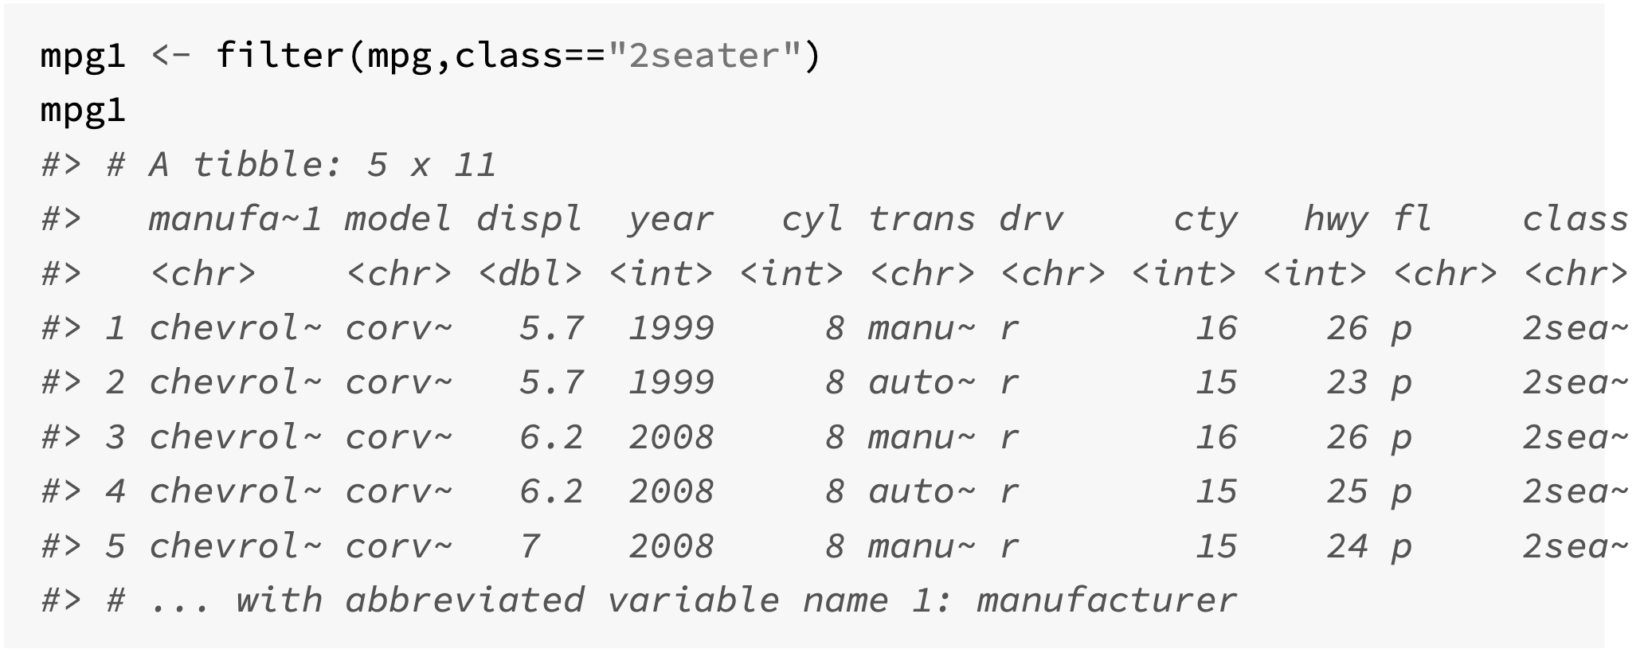
Filtering rows with filter()
Used to subset a tibble
Arguments
A data frame/tibble
A list of expressions that return a logical value and are defined in terms of variables that are present in the data frame
All columns returned

Slide 7
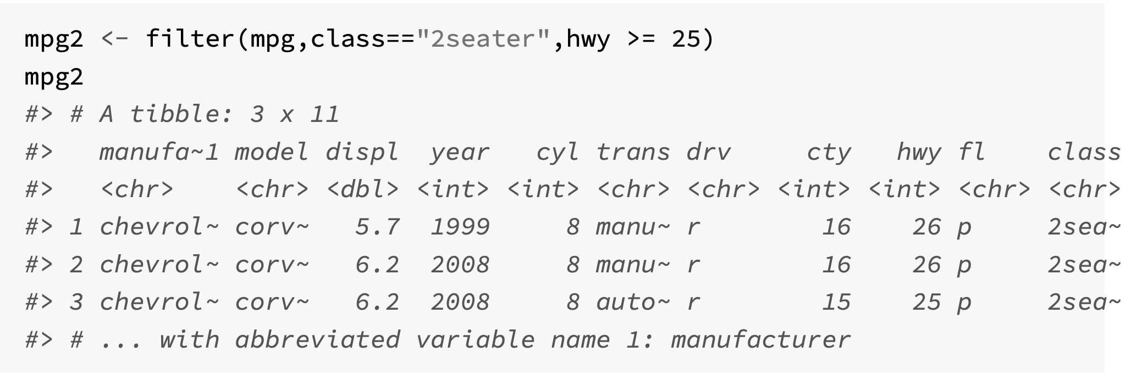
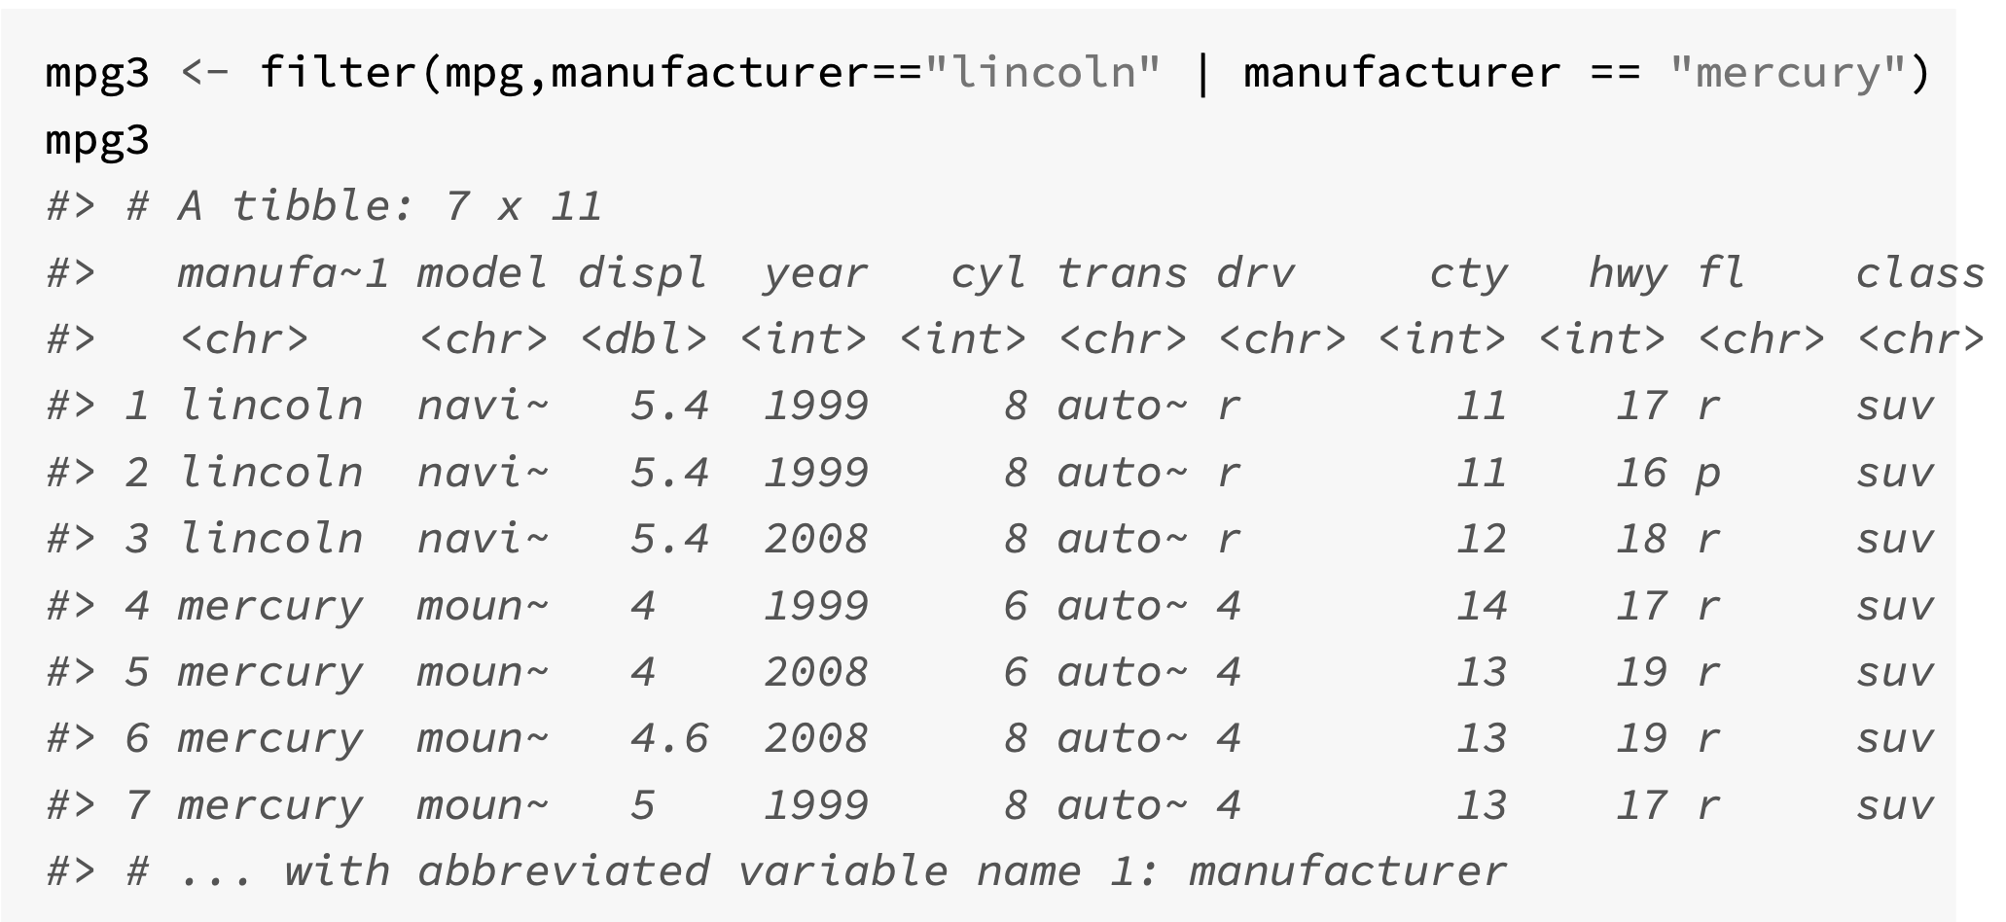

Slide 8
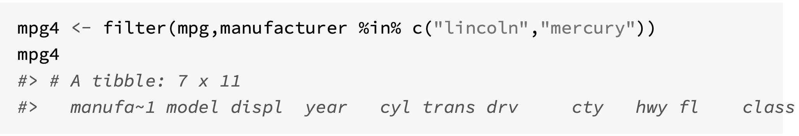
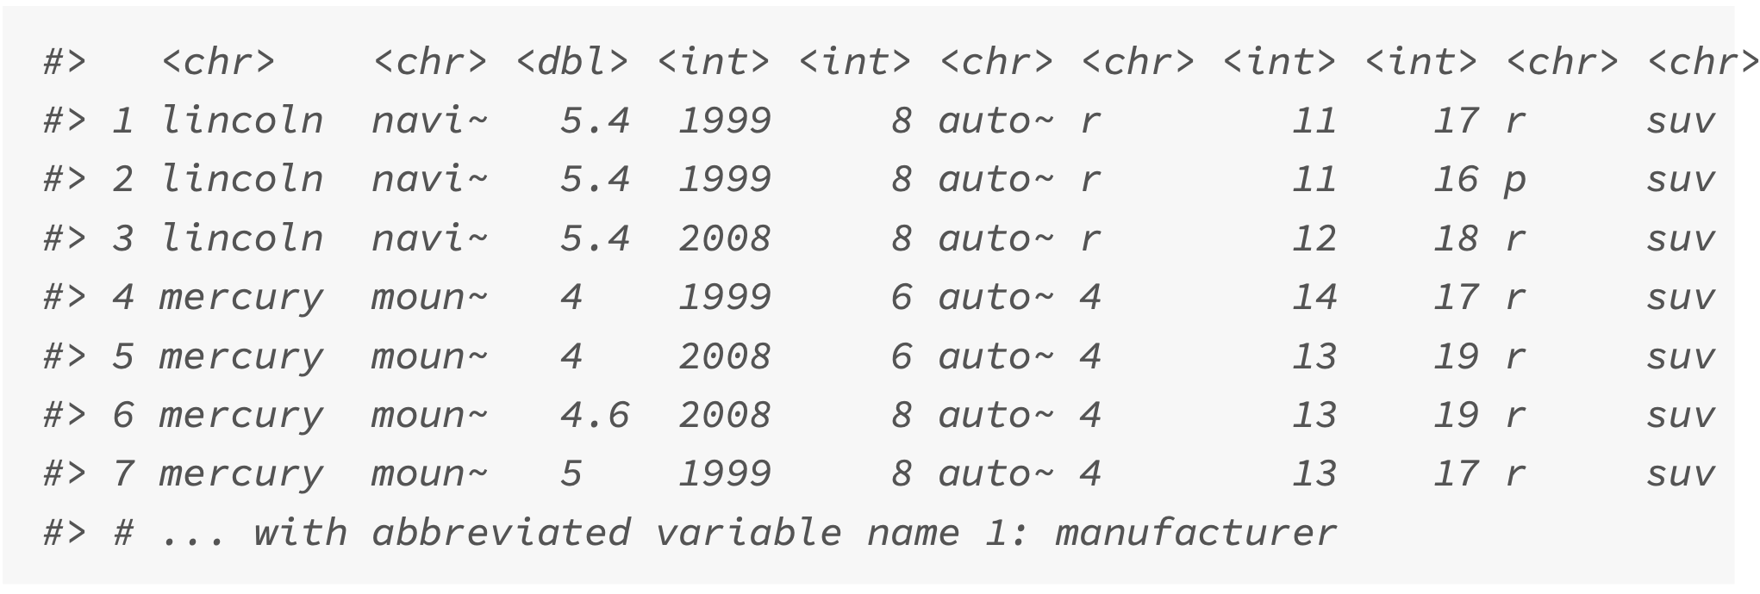

Slide 9
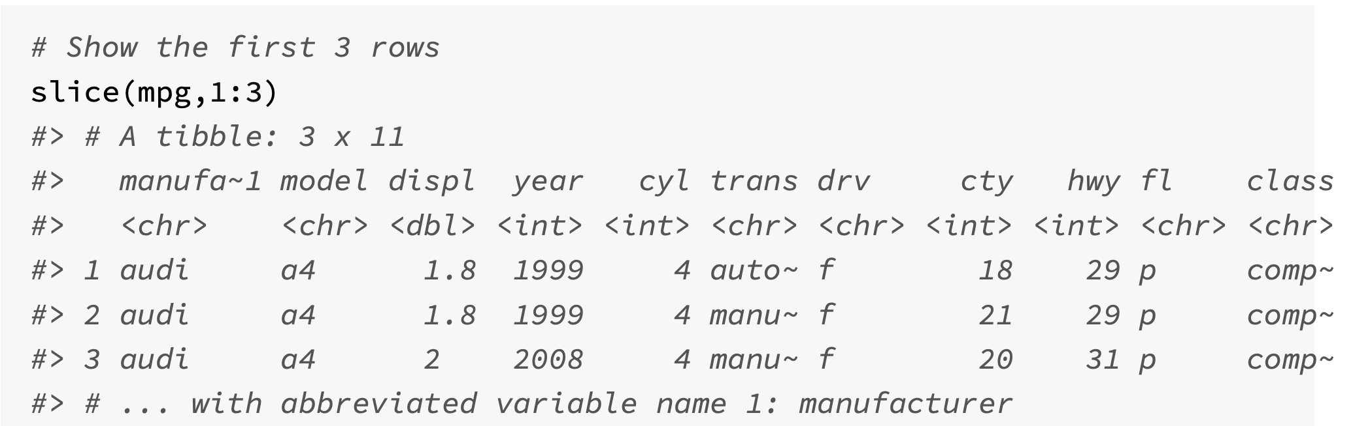
The slice() function

Slide 10
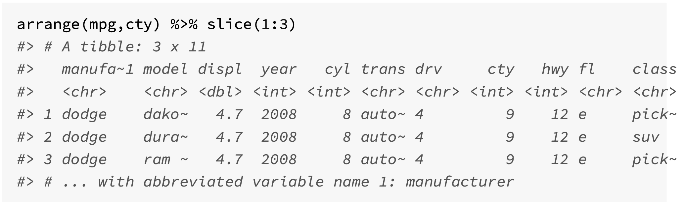
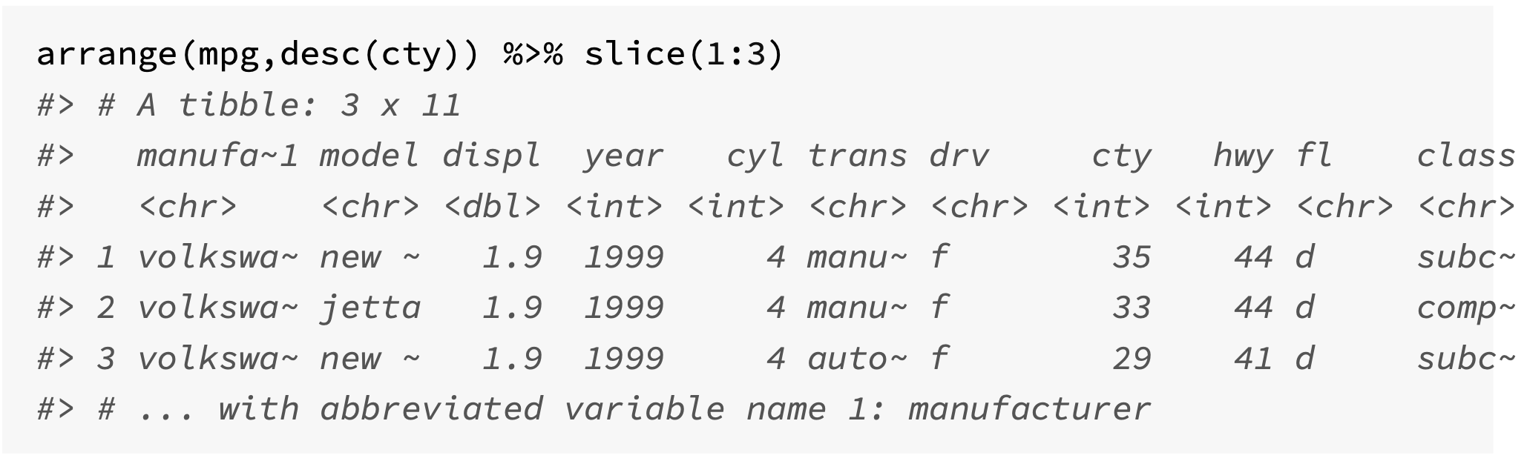
Sorting rows with arrange()

Slide 11
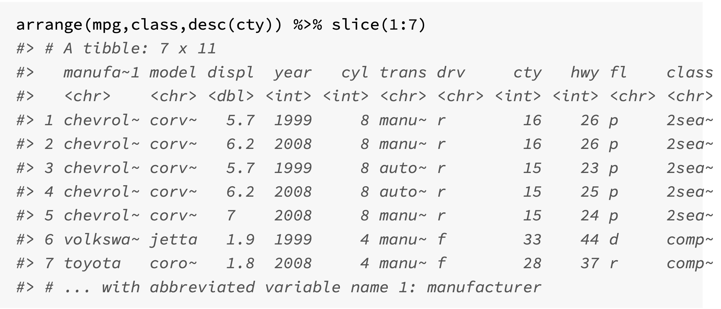
Using more than one sorting variable

Slide 12
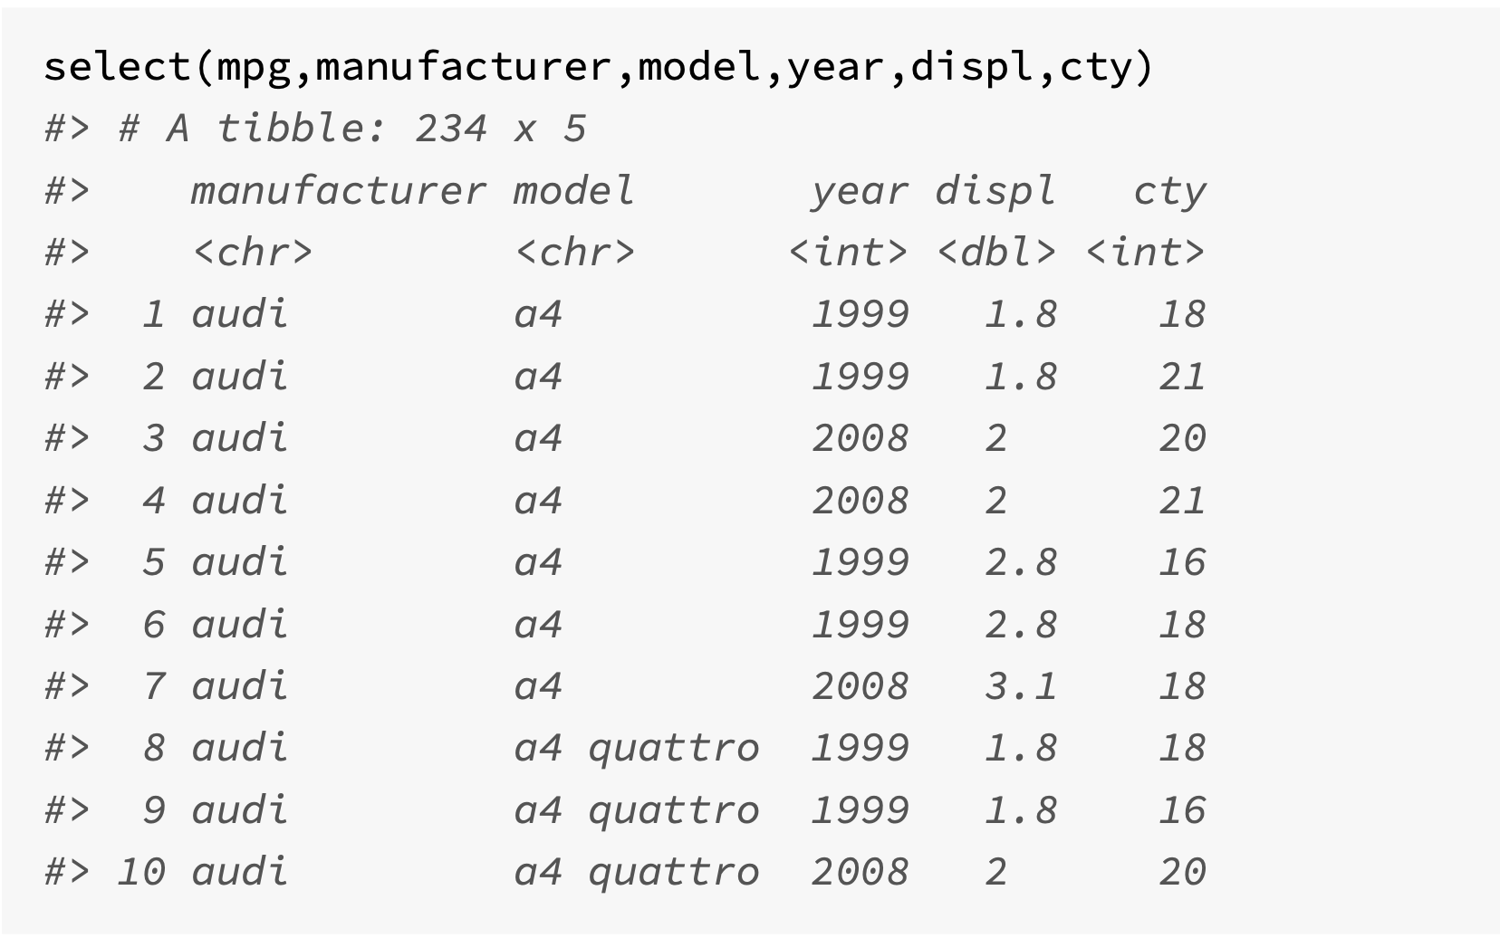
Choosing columns with select()
Enables you to subset columns from the input tibble
select() will always return all the observations
Simplest use is to write the column names that are required.

Slide 13
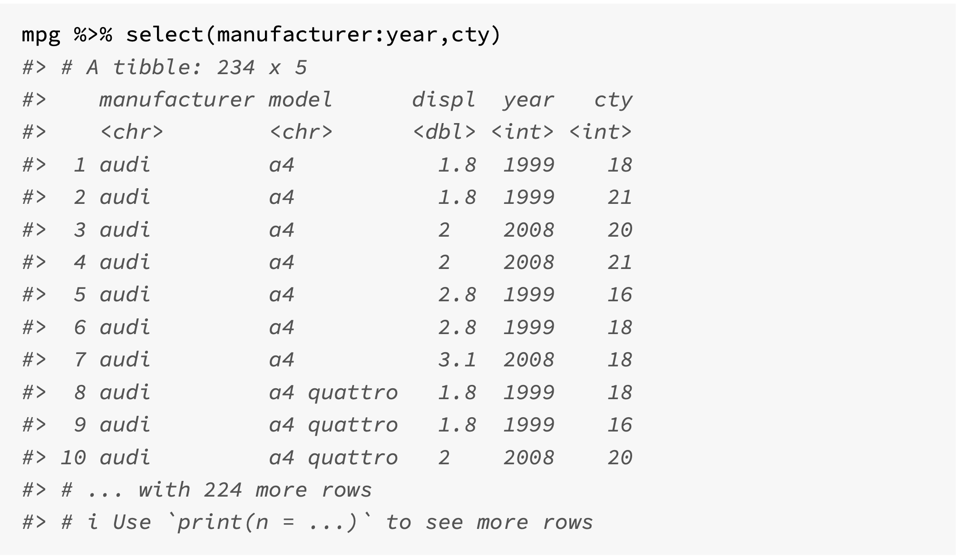
Use : for selecting a range of consecutive variables

Slide 14
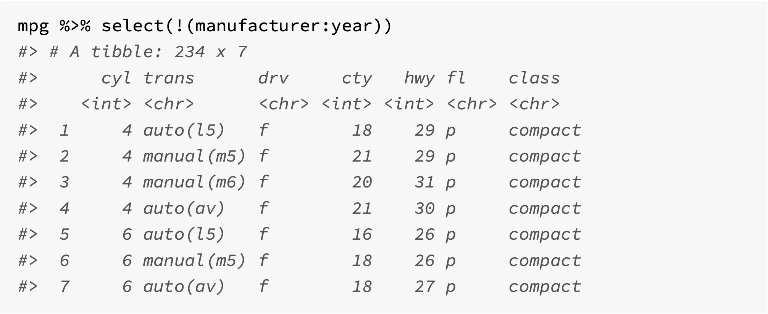
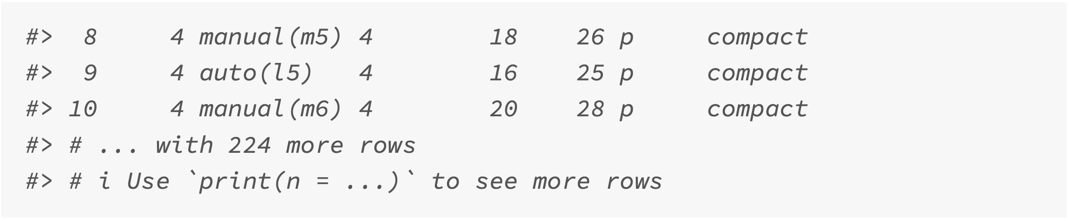
! For the complement of a collection of variables

Slide 15
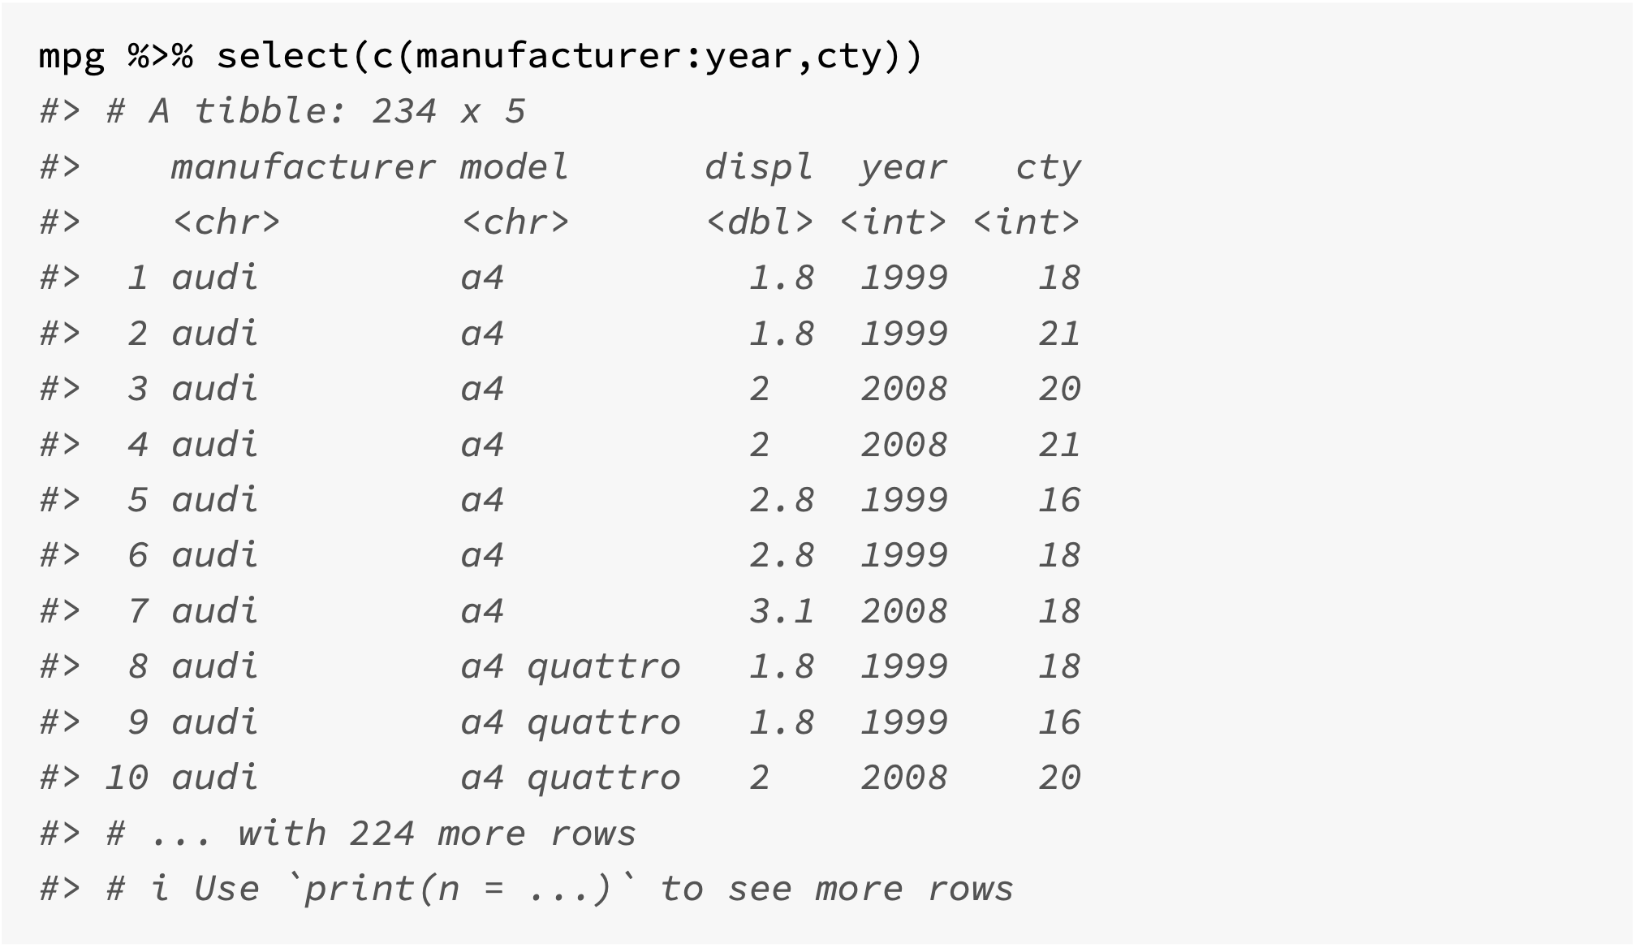
c() for combining selections

Slide 16
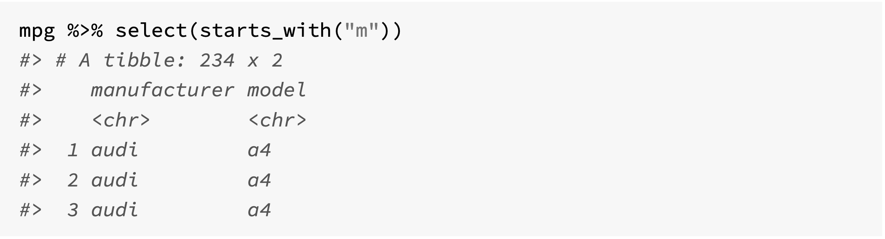
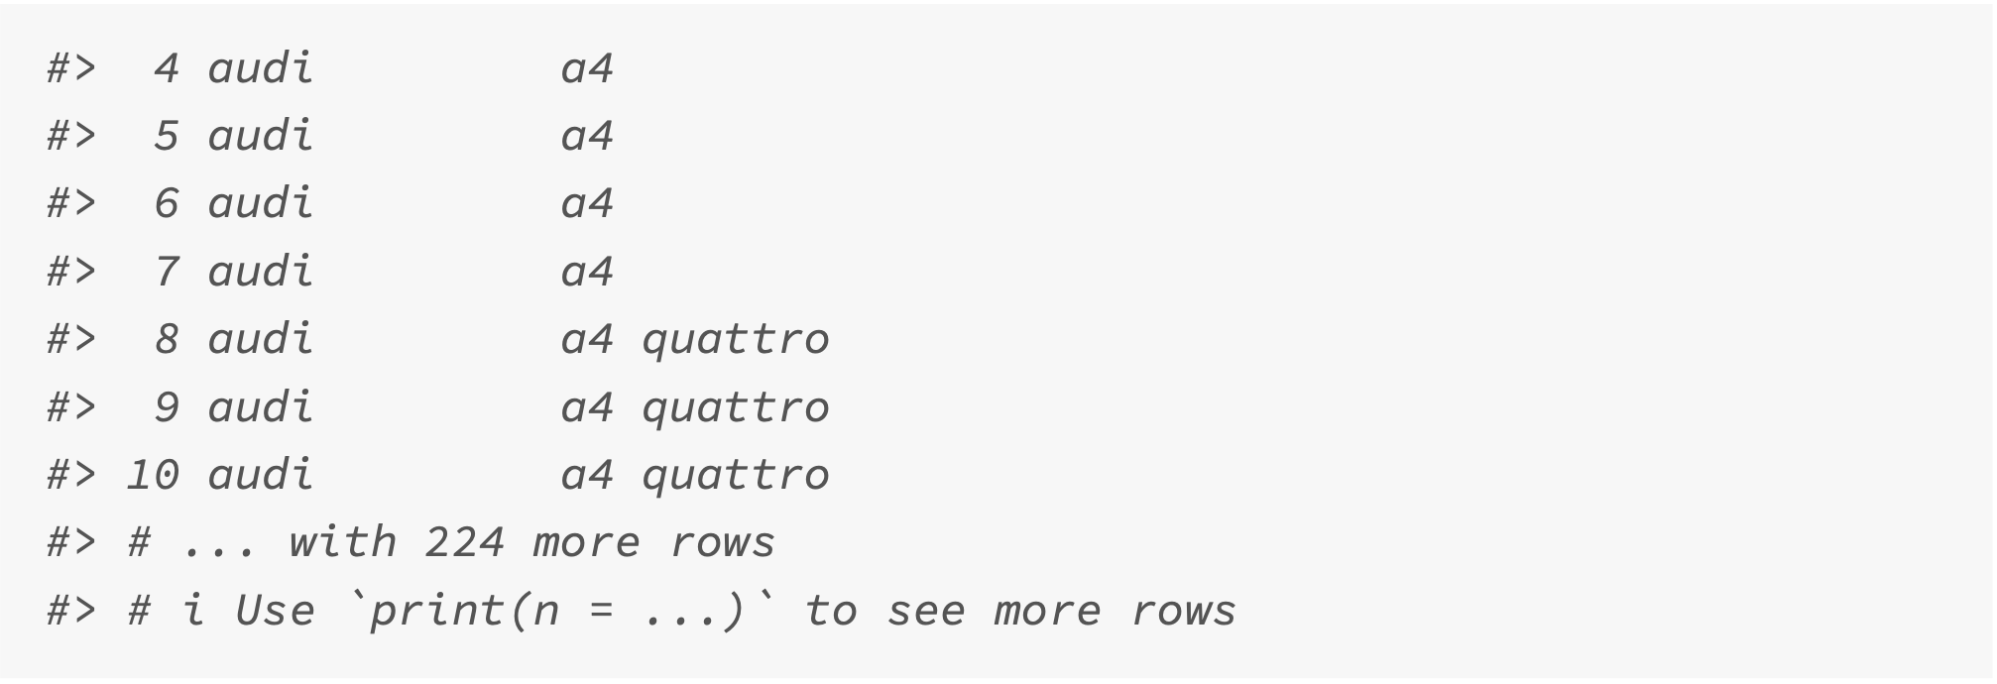
Selection helper: starts_with()

Slide 17
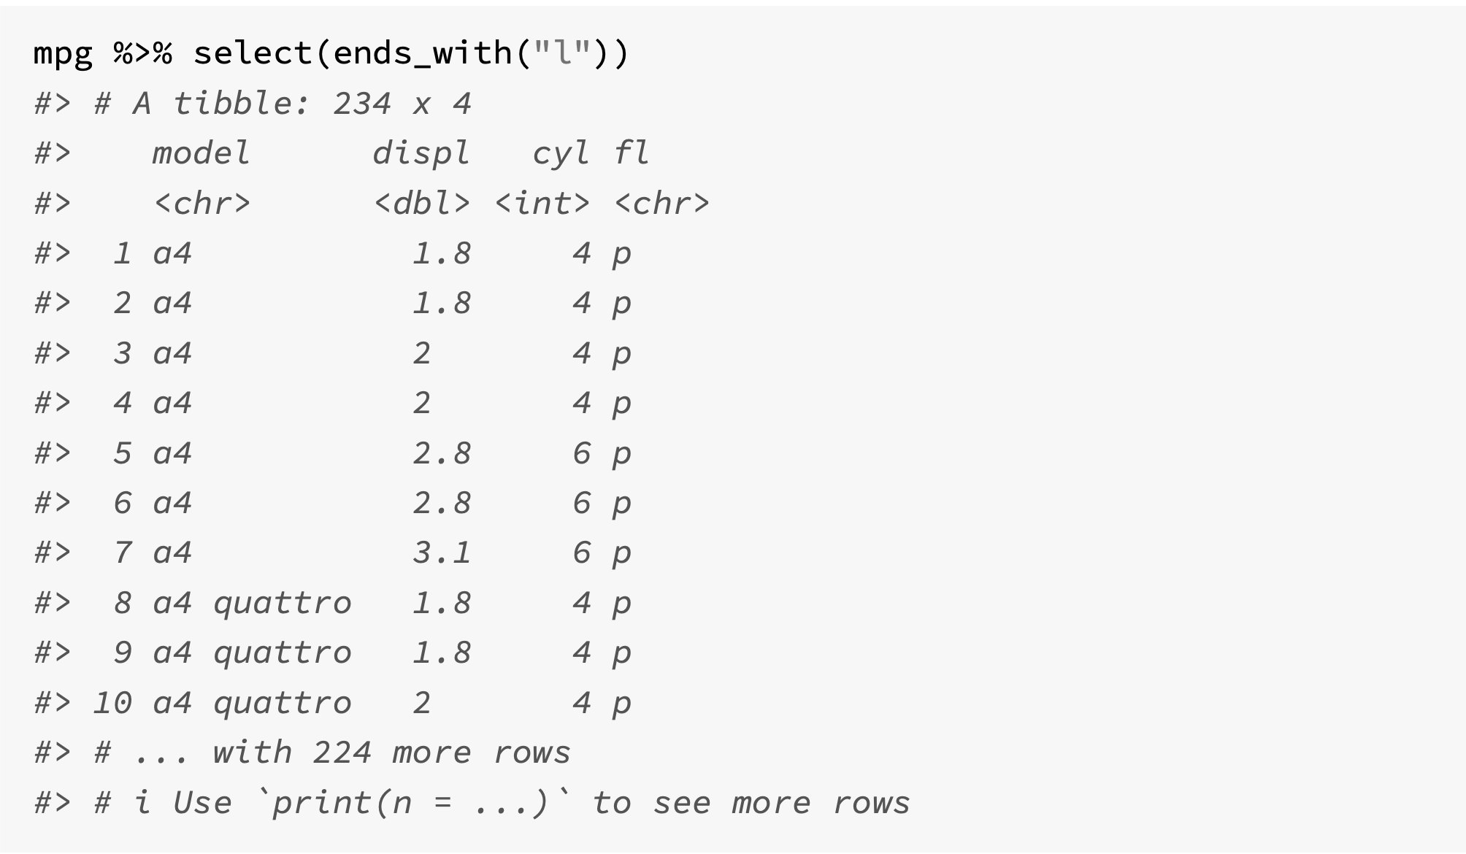
Selection helper: ends_with()

Slide 18
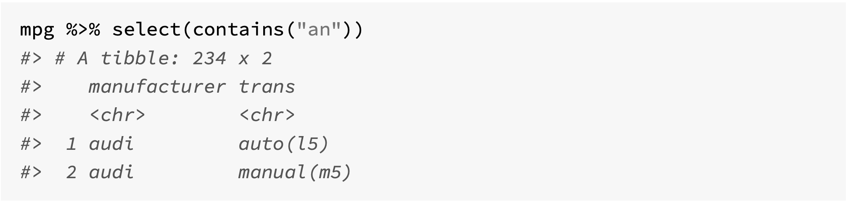
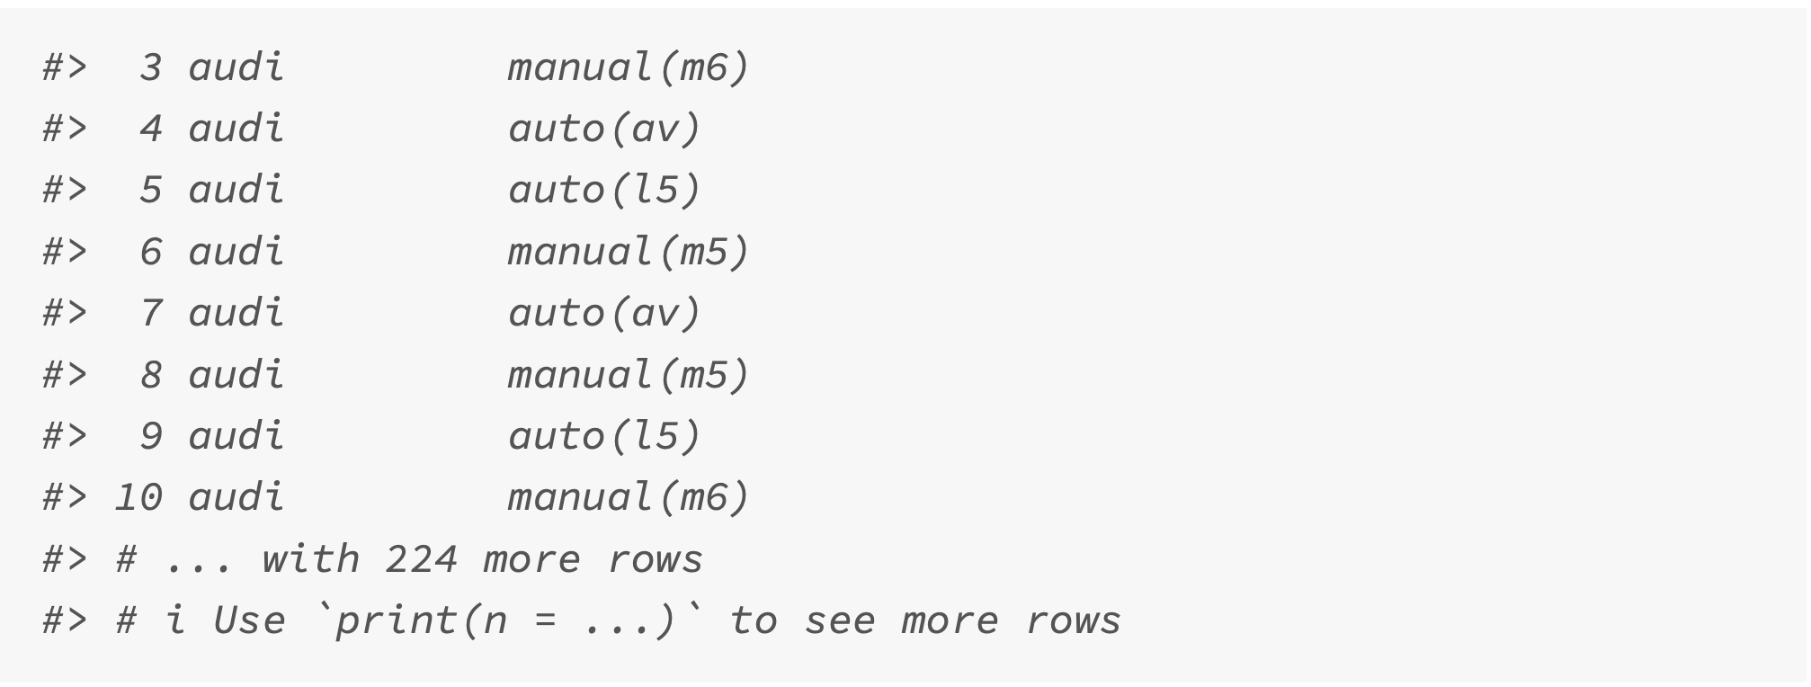
Selection helper: contains()

Slide 19
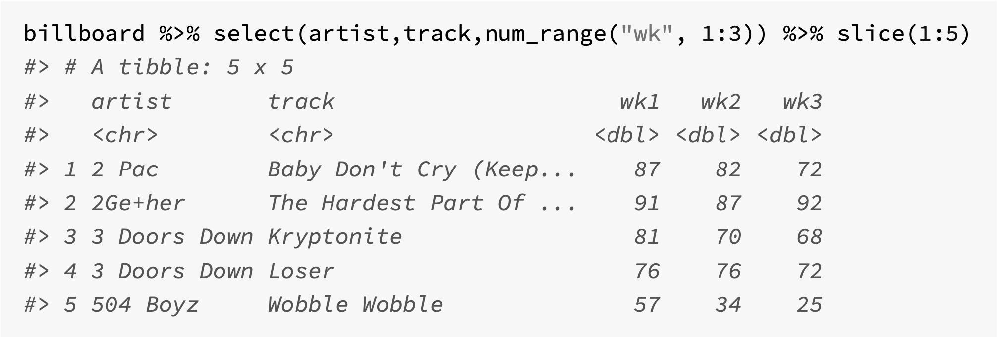
num_range() – prefix followed by numbers

Slide 20
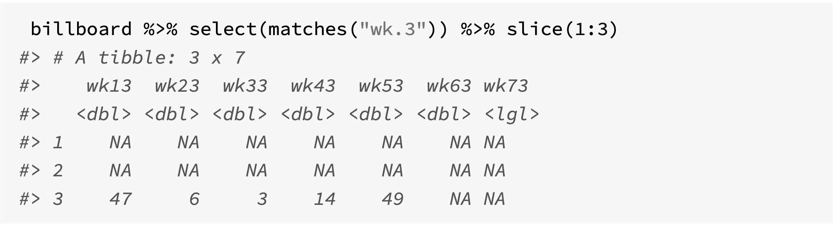
matches() – matches a regular expression pattern
The pattern here is to find a column that starts with “wk” and then contains any character (“.”) and concludes with the character “3”.

Slide 21
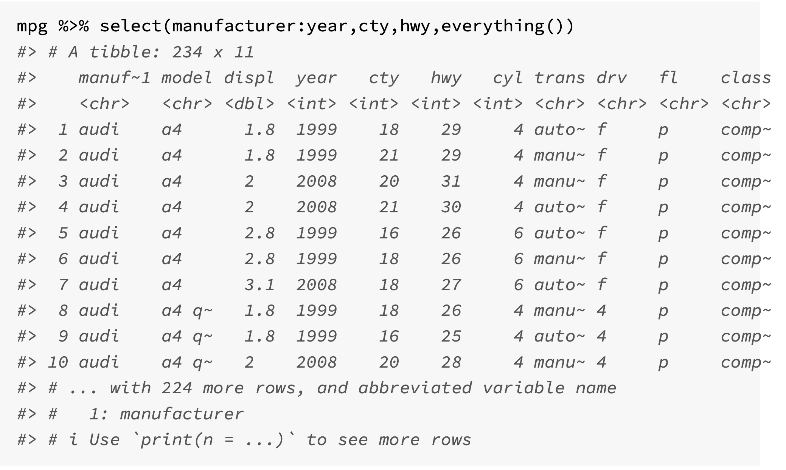
everything() – matches all remaining columns

Slide 22
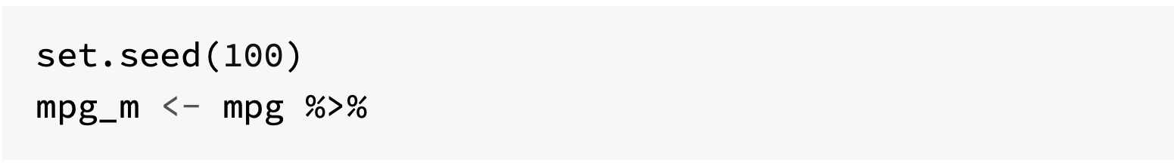
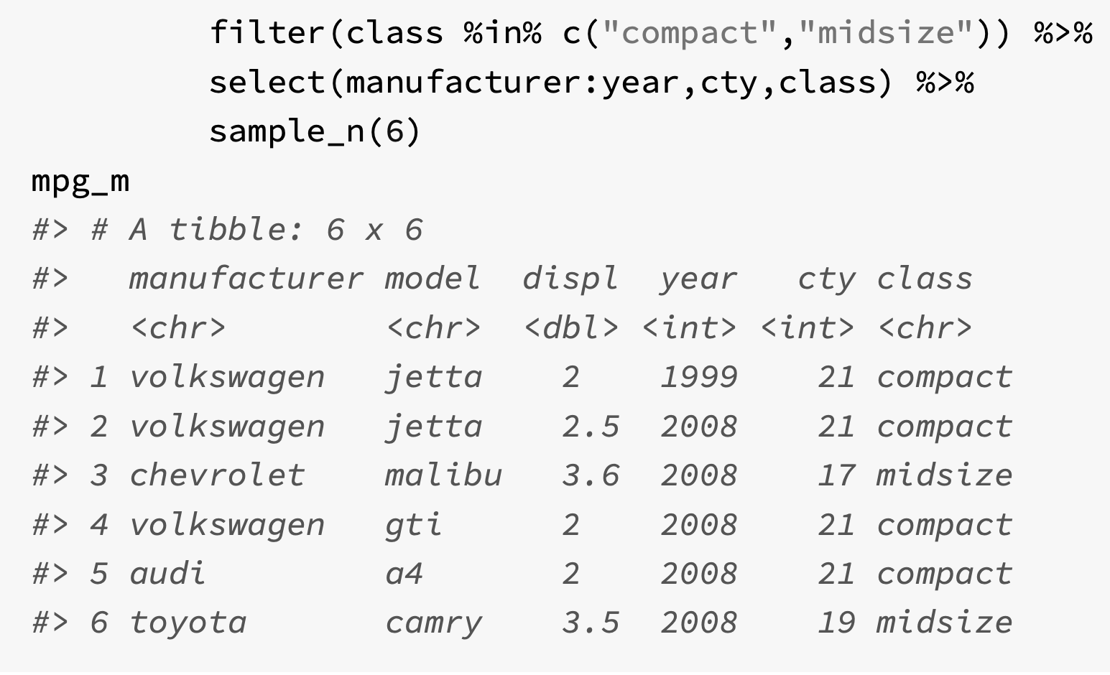
Adding columns with mutate()
The function mutate() adds new variables to a tibble, while keeping the original ones
It also allows for variables to be overwritten, and variables can be deleted by setting their values to NULL
Arguments:
tibble that is to be transformed
name-value pairs. Which can be a vector of length 1 (then recycled), a vector of the same length as the tibble, or NULL.

Slide 23
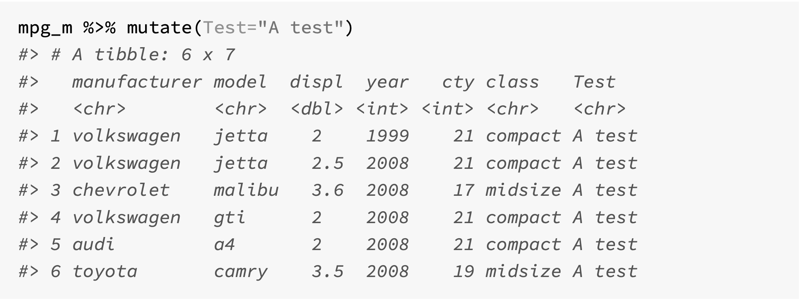
Adding vector of size 1

Slide 24
Adding a vector of the same length

